Slide 1
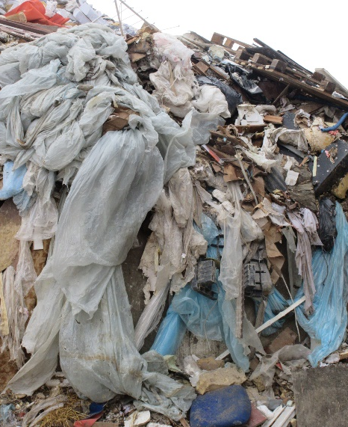
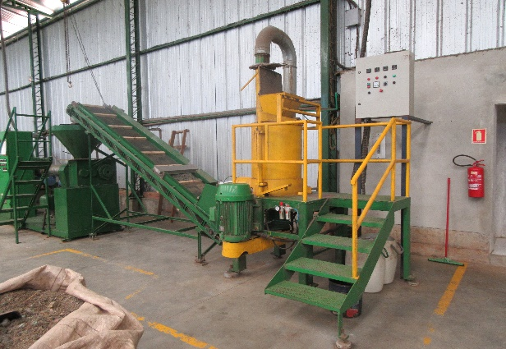
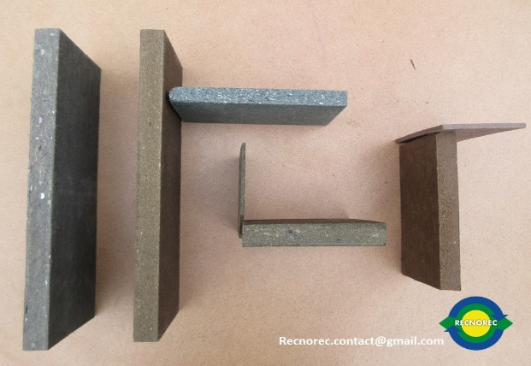
RECNOREC
Recycle non recyclable waste from France, Europe and International…

Slide 2
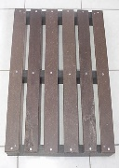
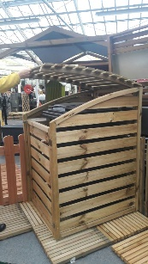
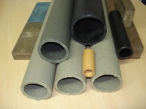
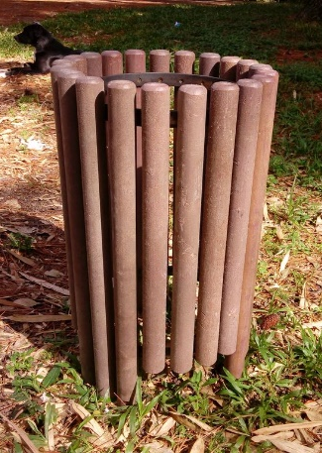
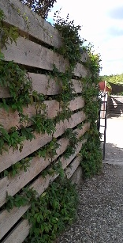
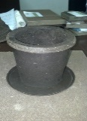
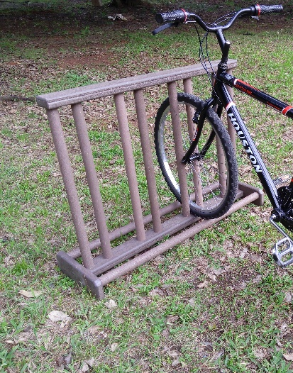
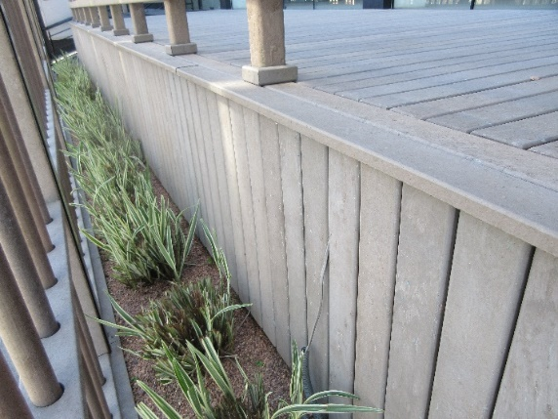
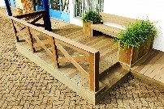
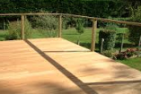
AN AMAZING MATERIAL
Strong
Soft
Beautiful
Easy to manufacture
Splinterless
Water
Chemical
Weather
UV
Recyclable
Resistant

Slide 3
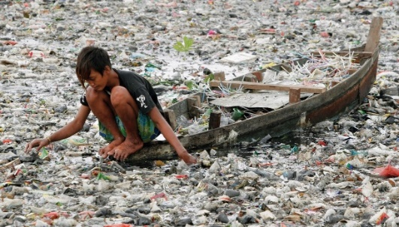
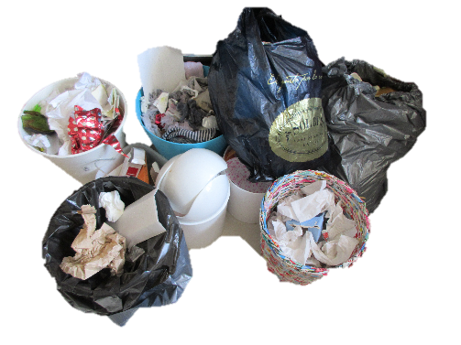
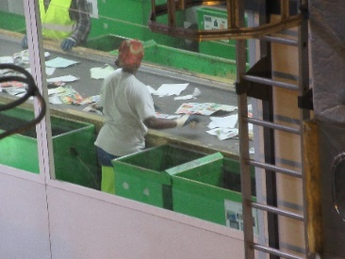
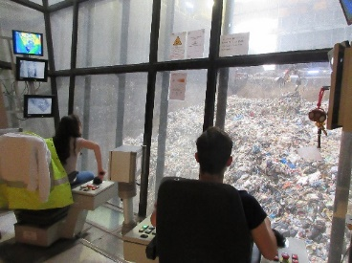
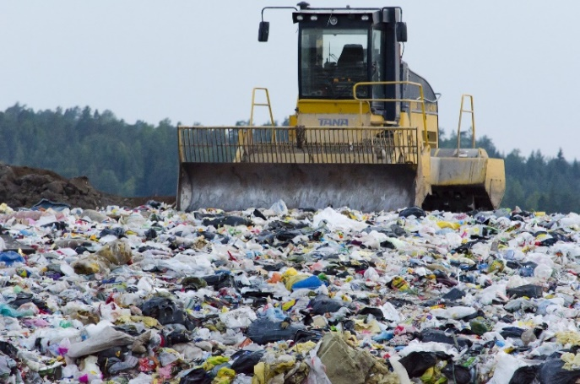
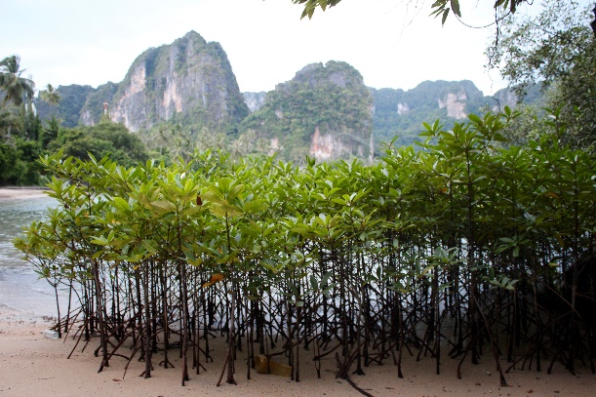
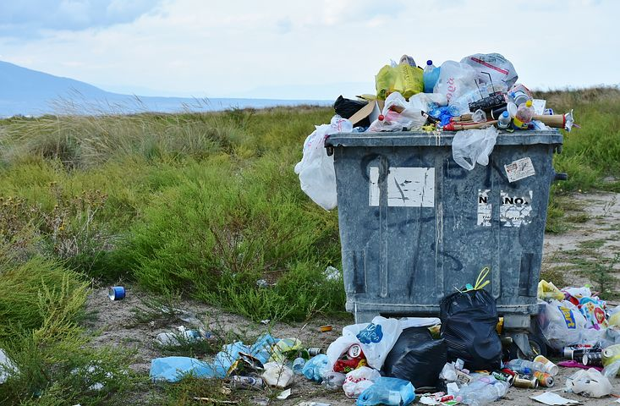
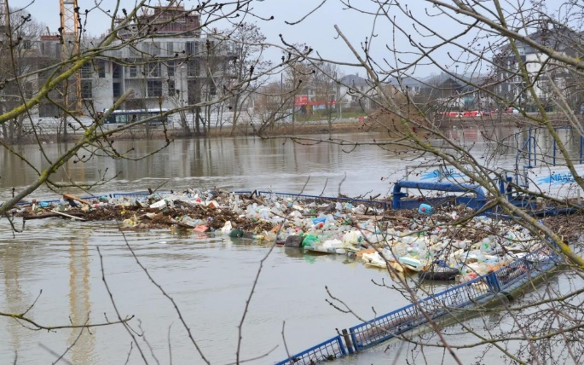
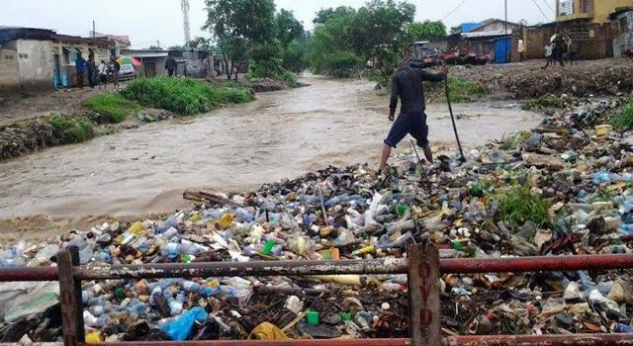
RECNOREC SECONDARY RAW MATERIAL IS A 100% GARBAGE COMPOSITE
No real decrease
No sustainable solution
FINAL WASTE
150 Million Tons
270 kg/capita/y
Sanitary drama
Environmental today and long-term disaster
All countries and natural areas are impacted

Slide 4
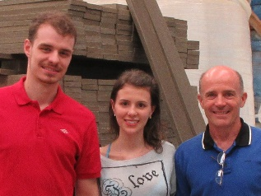
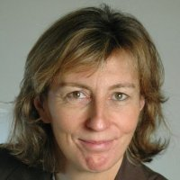
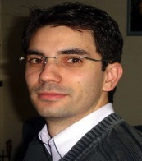
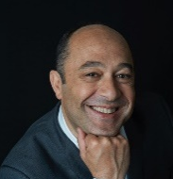
AN OBVIOUS COMMITTMENT
THROUGH AN AMBITIOUS VISION
A growing team around Ugoline and Oksana, the 2 co-founders
Future staff, key partners
Sponsors and many other contributors
RECNOREC dream can come true :
Let’s build together
a « positive-waste » society !
Composite competitors // RECNOREC
Produce non-recyclable
composite
from wood and plastic
recyclable waste
Produce recyclable
composite
from non-recyclable
garbage

Slide 5
RECNOREC OFFERS HIGHLY EFFICIENT SOLUTION
RECNOREC 4 major issues
1-Plastic waste management (-> innovative technology)
2-Natural recources preservation (-> alternative to wood and plastic)
3-Industrial relocation (-> local plants)
4-Inclusion and social mixity (-> modern and fair wealth-sharing)
1 Ton waste recycled by RECNOREC
=
1 Ton landfill avoided
=
1 Ton sustainable and affordable material produced
=
1 Ton natural resources preserved

Slide 6
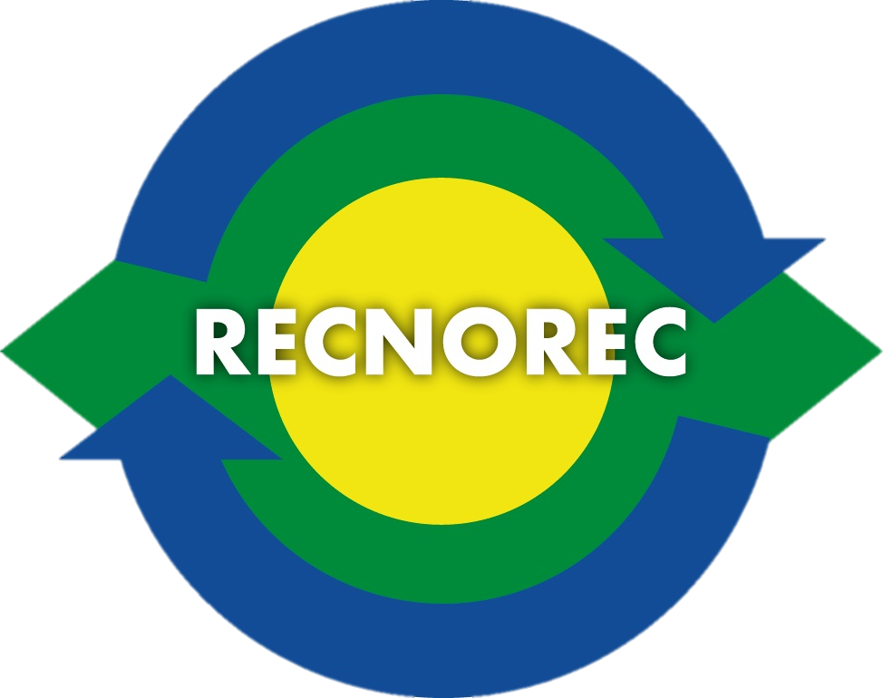
RECNOREC SOLUTION
FOR SOCIAL AND ECONOMIC BENEFITS
Social business
network
An industrial network
Local-scaled plants
Environment-friendly partners
Short-channels economy
Promote local production
Minimum 30 created jobs / plant
Consolidate local economic network and existing jobs
Partnerships with local craft-people
Inclusion and diversity
Less public charges
Limit unemployment
More local growth
Improve environmental targets

Slide 7
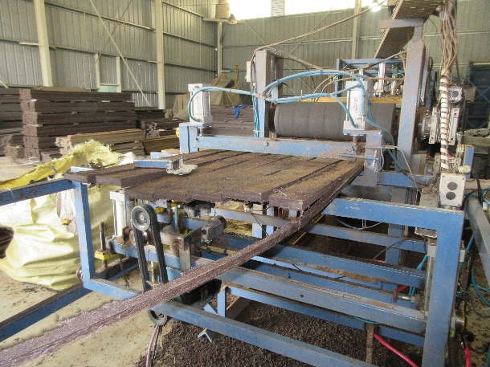
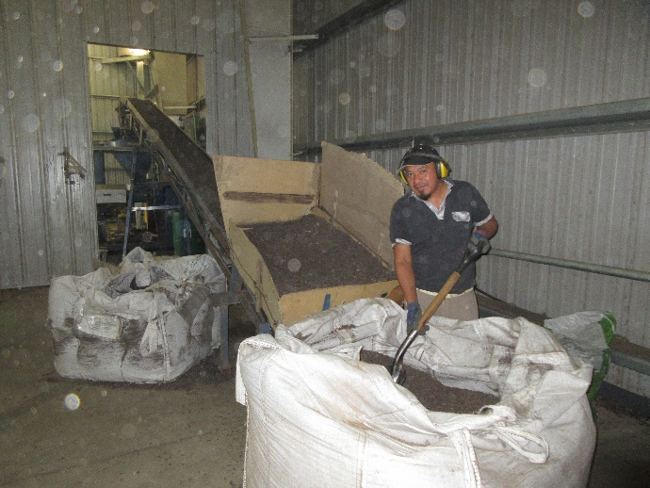
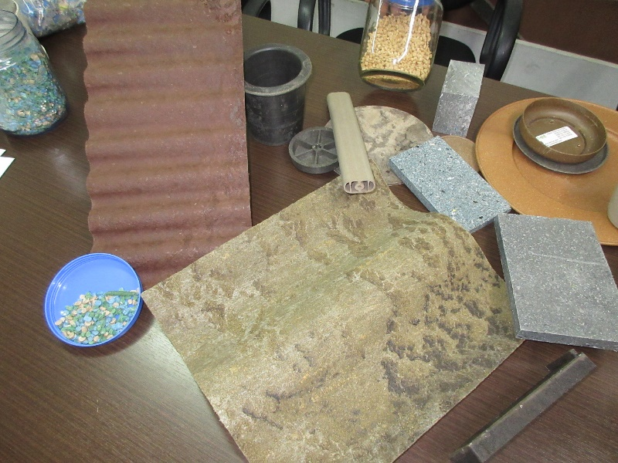
RECNOREC INCREDIBLE TECHNOLOGY
Already operating
Craft-technology small scale
Various plants in South-America
Empirical and family know-how
Passionate Social entrepreneurs
Large range of waste
Local municipal waste
Farmers dirty plastics
Industrial waste
etc
Machines operate through specific waste « recipes »
Large range of applications
Beautiful recyclable material
Strong and multi shapable

Slide 8
RECNOREC PLANS AN INDUSTRIAL SCALING-UP THROUGH 3 STAGES
2018-Worshop: transform Final Waste into sustainable material
Adapt to local waste
Find best applications
Create Social industry operational model
R&D + innovation
x 100
2019-Prototype: scale up craft-technology
From 300 Tons/y to 30 000 Tons/year
Scaled for 200 000 inhab 30% final waste
Social business
2021-Industrial Plants: a plant for each territory Local scalable waste solution
Minimum transport
Maximum job creations
Inclusion and diversity

Slide 9
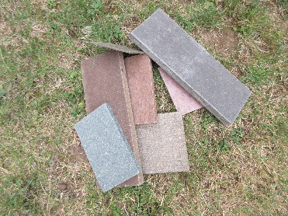
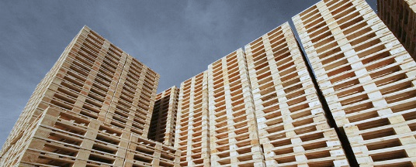
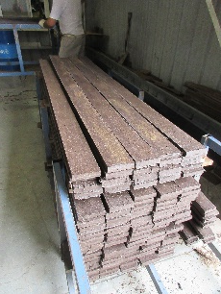
RECNOREC IMMEDIATE, SHORT AND MEDIUM TERM…
Workshop (mid 2018)
20 kg/hour
Investment 30 k€
R&D cost 100 k€
Other cost 170 k€
2 persons
Turnover 10 k€
Prototype (Mid 2019)
500 Tons/year
Investment 800 k€
R&D cost 300 k€
Other cost 550 k€
6 persons
Turnover 130 k€
1st Plant (2021)
30 000 Tons/year
Investment 12 000 k€
R&D cost 800 k€
Other cost 7 500 k€
30 persons
Turnover 12 600 k€

Slide 10
TOMORROW with GSVC2018…
How will RECNOREC use the grant in 2018 ?
3000€ 2 palets imported material for test s
10 000 € 40% pilot machines
25 000 € 100% pilot machines
40 000 € 100% pilot machines + workshop arrangement
+ 6 months operating to produce our samples
Help us build next year our mini-plant
to transform 500 first Tons…

Slide 11
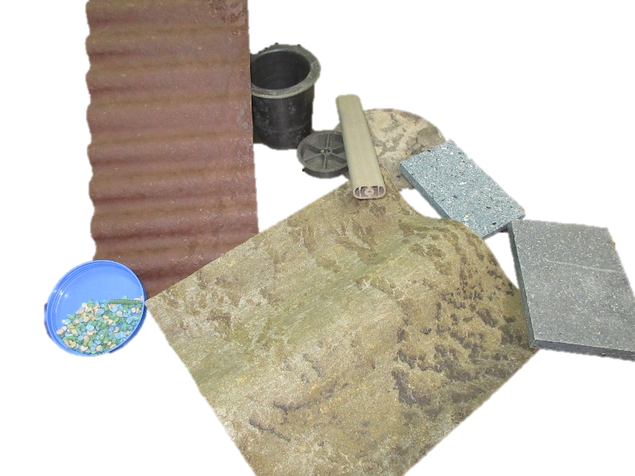
RECNOREC TRADITIONNAL RECYCLING BUSINESS MODEL
Preparing POC (2018)

Slide 12
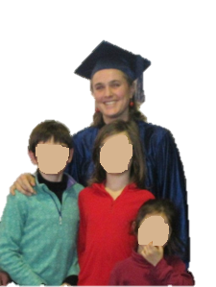
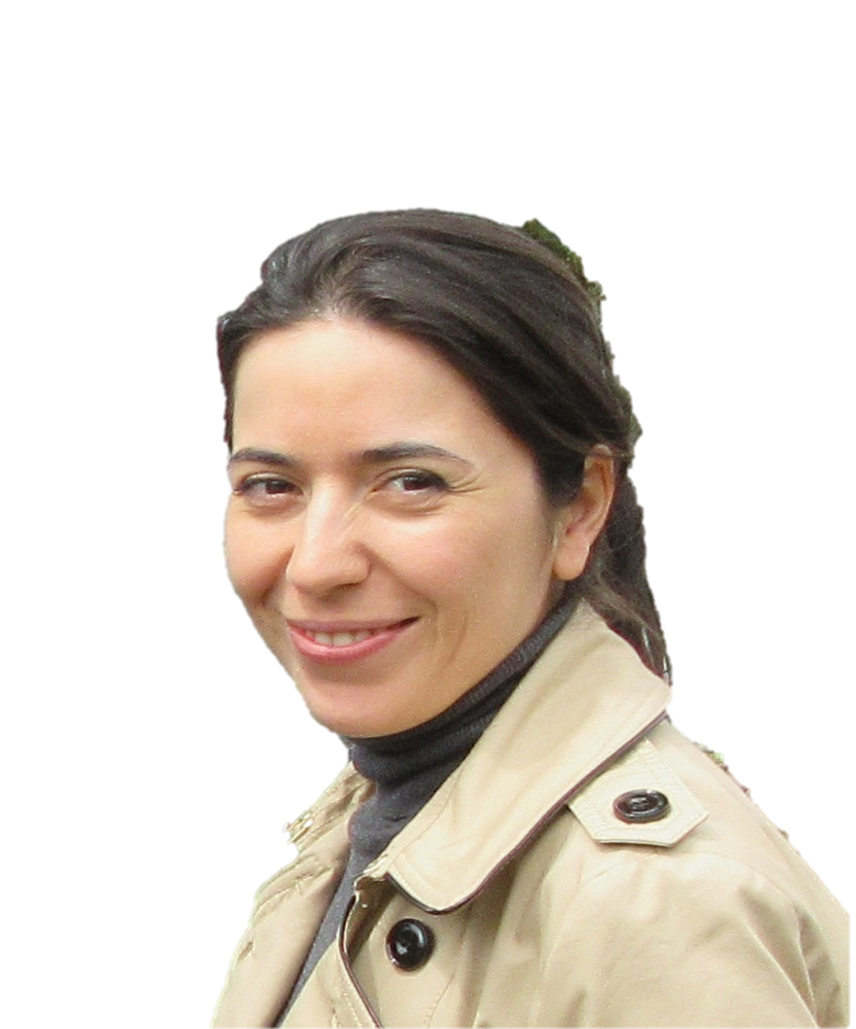
RECNOREC IS REGISTERED AS SOCIAL BUSINESS
After 20 years Environment management background
2015 meeting with Oksana
2017 graduated from Social business management
Hosted in territorial SQYCub incubator (2017)
First local partnership projected on 220 000 inhab area
A Social Simplified Joint-Stock Company (2018)
(French Social SAS)
Social Business fundamentals Statute
An reliable and ambitious industrial project… From Brazil… to France… to International

Slide 13
Thank you for your attention

